Slide 1

DISCRETE MATHEMATICS
Chapter 5:
BOOLEAN ALGEBRA
Presenter: Ph.D. Phu-Nguyen Le
June 7th, 2023
1

Slide 2
Introduction
5.1. DEFINITION.
5.1.1 Definition of Boolean algebra.
5.1.2. Properties.
5.2. BOOLEAN FUNCTION.
5.2.1. Definition
5.2.2. Performance.
5.2.3. Logic gates
5.3. MINIMIZATION OF BOOLEAN FUNCTIONS.
    5.3.1. Definition.
    5.3.2. Variable method.
    5.3.3. Karnaugh map
2

Slide 3

5.1 DEFINITION
5.1.1 Definition of Boolean algebra
In Boolean algebra, a variable is a symbol used to represent an action, a condition, or data. A single variable can only have a value of 1 or 0.
The complement represents the inverse of a variable and is indicated with an overbar. Thus, the complement of A is $\overline{A}$.
The complement represents the inverse of a variable and is indicated with an overbar. Thus, the complement of A is A.
3

Slide 4

5.1 DEFINITION
5.1.1 Definition of Boolean algebra
Addition is equivalent to the OR operation. The sum term is 1 if one or more if the literals are 1. The sum term is zero only if each literal is 0
Determine the values of A, B, and C that make the sum term of the expression $\overline{A}$ + B + C = 0?
4

Slide 5
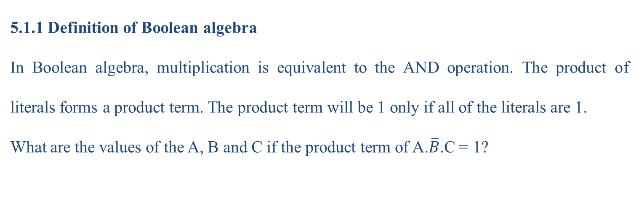
5.1 DEFINITION
5.1.1 Definition of Boolean algebra
In Boolean algebra, multiplication is equivalent to the AND operation. The product of literals forms a product term. The product term will be 1 only if all of the literals are 1.
What are the values of the A, B and C if the product term of A.$\overline{B}$.C = 1?
5

Slide 6
5.1.2 PROPERTIES
Commutative Laws
The commutative laws are applied to addition and multiplication.
For addition, the commutative law states
In terms of the result, the order in which variables are ORed makes no difference.
A+B=B+A
For multiplication, the commutative law states
In terms of the result, the order in which variables are ANDed makes no difference.
A+B=B+A
6

Slide 7
5.1.2 PROPERTIES
Associate Laws
The associative laws are also applied to addition and multiplication.
For addition, the associative law states.
When ORing more than two variables, the result is the same regardless of the grouping of the variables.
(A+B)+C=A+(B+C)
For multiplication, the associative law states
When ANDing more than two variables, the result is the same regardless of the grouping of the variables.
A+B=B+A
7

Slide 8
5.1.2 PROPERTIES
Distributive Law
The distributive law is the factoring law. A common variable can be factored from an expression just as in ordinary algebra. That is
(A+B)C=AC+BC
8

Slide 9
5.2 BOOLEAN FUNCTION
5.2.1 Definition
Given a set B={0,1}, and a function f=f(x₁,x₂,…,x_{n}) that has value of B. Boolean function of n variable is defined:
f= B^{n} ->B, for B={0,1}
9

Slide 10

5.2 BOOLEAN FUNCTION
5.2.2 Performance
Rules of Boolean Algebra
    1. A+0=A 6. A+$\overline{A}$=1
    2. A+1=1
    3. A.0=0
    4. A.1=A
    5. A+A=A
9

Slide 11

5.2 BOOLEAN FUNCTION
Rules of Boolean Algebra
    A.A=A
    A. $\overline{A}$=0
    A=$\overset{̿}{A}$
    A + AB = A
    A + $\overline{A}$B = A + B
    (A + B)(A + C) = A + BC
10

Slide 12
5.2 BOOLEAN FUNCTION
Illustrate the rules
11

Slide 13

5.2 BOOLEAN FUNCTION
De Morgan’s 1st Theorem
The complement of a product of variables is equal to the sum of the complemented variables
$\overline{A}$ $+\overline{B}=\overline{AB}$
12

Slide 14

5.2 BOOLEAN FUNCTION
De Morgan’s 2nd Theorem
The complement of a sum of variables is equal to the product of the complemented variables.
$\overline{A}$ $.\overline{B}=\overline{A+B}$
12

Slide 15
5.2 BOOLEAN FUNCTION
De Morgan’s 2nd Theorem
The complement of a sum of variables is equal to the product of the complemented variables.
$\overline{A}$ $.\overline{B}=\overline{A+B}$
14

Slide 16
5.2 BOOLEAN FUNCTION
SOP and POS
Boolean expressions can be written in the sum-of-products form (SOP) or in the product-of-sums form (POS). These forms can simplify the implementation of combinational logic, particularly with PLDs. In both forms, an overbar cannot extend over more than one variable.
An expression is in SOP form when two or more product terms are summed as in the following examples:
A B C + A B A B C + C D C D + E
16

Slide 17
5.2 BOOLEAN FUNCTION
SOP and POS
An expression is in POS form when two or more sum terms are multiplied as in the following examples:
(A + B)(A + C) (A + B + C)(B + D) (A + B)C
17

Slide 18
5.2 BOOLEAN FUNCTION
SOP and POS
An expression is in POS form when two or more sum terms are multiplied as in the following examples:
(A + B)(A + C) (A + B + C)(B + D) (A + B)C
18

Slide 19
5.2 BOOLEAN FUNCTION
SOP and POS standard form
In SOP standard form, every variable in the domain must appear in each term. You can expand a nonstandard term to standard form by multiplying the term by a term consisting of the sum of the missing variable and its complement
In POS standard form, every variable in the domain must appear in each sum term of the expression. You can expand a nonstandard POS expression to standard form by adding the product of the missing variable and its complement and applying rule 12,
19

Slide 20
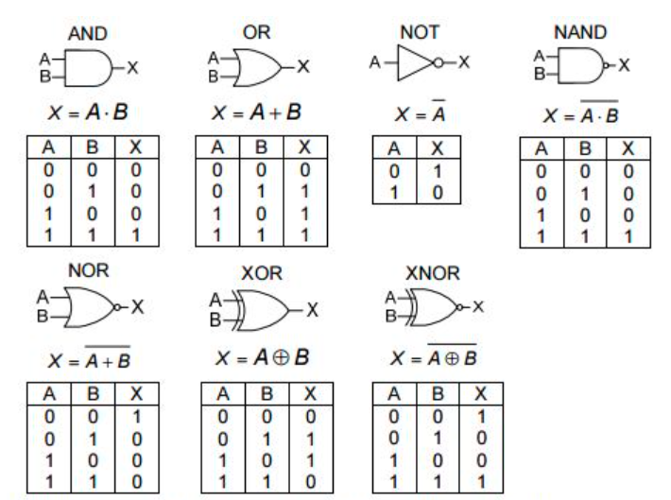
5.2 BOOLEAN FUNCTION
5.2.3 Logic gates
19

Slide 21
5.3. MINIMIZATION OF BOOLEAN FUNCTIONS.
5.3.1 Definition
Minimization of Boolean functions is a crucial concept in digital logic design and optimization.
Boolean functions are mathematical expressions that describe the relationships between input variables and their corresponding output values using logical operators such as AND, OR, and NOT. The goal of minimization is to simplify these functions while retaining their logical behavior, leading to more efficient and compact digital circuits.
21

Slide 22
5.3. MINIMIZATION OF BOOLEAN FUNCTIONS.
5.3.1 Definition
Importance of Minimization:
Reduced Complexity: Minimizing Boolean functions reduces the number of logic gates and connections required to implement a circuit, leading to simpler and more cost-effective designs.
Faster Circuits: Smaller circuits result in shorter propagation delays, leading to faster operation and better overall performance.
Lower Power Consumption: Simplified circuits typically consume less power, making them energy-efficient and environmentally friendly.
22

Slide 23
5.3. MINIMIZATION OF BOOLEAN FUNCTIONS.
5.3.1 Definition
Methods of Minimization:
There are two primary methods for minimizing Boolean functions:
Algebraic Minimization (Variable method).
Karnaugh Map (K-map) Minimization.
23

Slide 24
5.3. MINIMIZATION OF BOOLEAN FUNCTIONS.
5.3.2 Variable method:
A logic expression can be reduced to its simplest form or changed to a more convenient form to implement the expression most efficiently using Boolean algebra. The approach taken in this section is to use the basic laws, rules, and theorems of Boolean algebra to manipulate and simplify an expression. This method depends on a thorough knowledge of Boolean algebra and considerable practice in its application, not to mention a little ingenuity and cleverness. After completing this section, you should be able to
◆ Apply the laws, rules, and theorems of Boolean algebra to simplify general expression
24

Slide 25
5.3. MINIMIZATION OF BOOLEAN FUNCTIONS.
5.3.2 Variable method:
Using Boolean algebra techniques, simplify this expression: AB + A(B + C) + B(B + C) Step 1: Apply the distributive law to the second and third terms in the expression, as follows: AB + AB + AC + BB + BC
Step 2: Apply rule 7 (BB = B) to the fourth term. AB + AB + AC + B + BC
Step 3: Apply rule 5 (AB + AB = AB) to the first two terms. AB + AC + B + BC
Step 4: Apply rule 10 (B + BC = B) to the last two terms. AB + AC + B
Step 5: Apply rule 10 (AB + B = B) to the first and third terms. B + AC
At this point the expression is simplified as much as possible. Once you gain experience in applying Boolean algebra, you can often combine many individual steps.
25

Slide 26

5.3. MINIMIZATION OF BOOLEAN FUNCTIONS.
5.3.2 Variable method:
Using Boolean algebra techniques, simplify this expression:
$A\overline{B} + A\left(\overline{B+C}\right)+ B\left(\overline{B+C}\right)$
$[A\overline{B}\left(C+BD\right)+\overline{A}\overline{B}]C$
$[AB\left(C+\overline{BD}\right)+\overline{AB}]CD$
$\overline{A}BC + A\overline{B}\overline{C}+\overline{A}\overline{B}\overline{C}+A\overline{B}C+ ABC$
$AB\overline{C}+\overline{A}\overline{B}C+\overline{A}BC+$ $\overline{A}\overline{B}\overline{C}$
$\overline{AB+AC}+$ $\overline{A}\overline{B}C$
$\overline{AB}+\overline{AC}+\overline{A}\overline{B}\overline{C}$
26

Slide 27

5.3. MINIMIZATION OF BOOLEAN FUNCTIONS.
5.3.2 Variable method:
Using Boolean algebra techniques, simplify this expression:
$A+AB+A\overline{B}C$
$\left(\overline{A}+B\right)C+ABC$
$A\overline{B}C$(BD+CDE)+ $A\overline{C}$
27

Slide 28
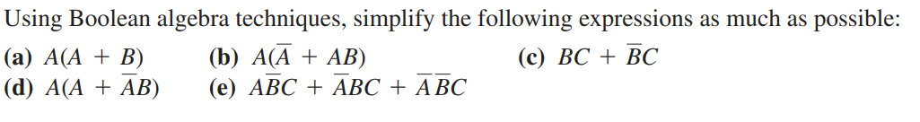
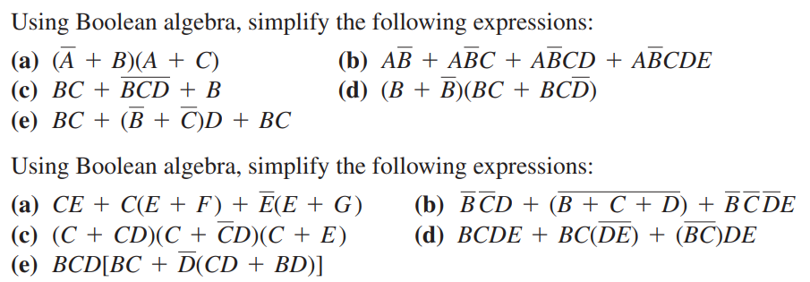
5.3. MINIMIZATION OF BOOLEAN FUNCTIONS.
5.3.2 Variable method:
28

Slide 29
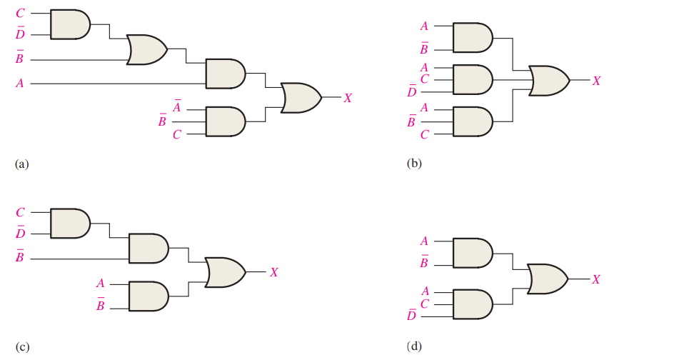
5.3. MINIMIZATION OF BOOLEAN FUNCTIONS.
5.3.2 Variable method:
Determine which of the logic circuits in Figure 4–59 are equivalent
29

Slide 30
5.3. MINIMIZATION OF BOOLEAN FUNCTIONS.
5.3.3 K-map method: K-maps provide a graphical approach to simplifying Boolean functions with fewer variables. It involves grouping similar terms to eliminate redundant literals, resulting in a minimized expression.
Steps in K-map Minimization:
1.Create a K-map grid with rows and columns representing all possible input combinations.
2. Populate the K-map with the output values of the Boolean function.
3. Identify adjacent cells with 1s to form groups of 1s (rectangles) that cover as many cells as possible while being powers of 2 in size (1, 2, 4, 8, ...).
4. Write down the terms corresponding to the groups, combining literals as necessary.
5. The final minimized expression is obtained by summing up the terms from step 4.
30

Slide 31
5.3. MINIMIZATION OF BOOLEAN FUNCTIONS.
The Karnaugh map (K-map)
is a tool for simplifying combinational logic with 3 or 4 variables. For 3 variables, 8 cells are required
The map shown is for three variables labeled A, B, and C. Each cell represents one possible product term.
Each cell differs from an adjacent cell by only one variable.
31

Slide 32
5.3. MINIMIZATION OF BOOLEAN FUNCTIONS.
Cells are usually labeled using 0’s and 1’s to represent the variable and its complement.
The numbers are entered in gray code, to force adjacent cells to be different by only one variable.
Gray code
Ones are read as the true variable and zeros are read as the complemented variable.
32

Slide 33
5.3. MINIMIZATION OF BOOLEAN FUNCTIONS.
Alternatively, cells can be labeled with the variable letters. This makes it simple to read, but it takes more time preparing the map.
C C
Example
Read the terms for the yellow cells.
AB
AB
AB
AB
Solution
The cells are ABC and ABC.
33

Slide 34
5.3. MINIMIZATION OF BOOLEAN FUNCTIONS.
K-maps can simplify combinational logic by grouping cells and eliminating variables that change.
Example
Group the 1’s on the map and read the minimum logic.
Solution
1. Group the 1’s into two overlapping groups as indicated.
Read each group by eliminating any variable that changes across a boundary.
B changes across this boundary
The vertical group is read AC.
C changes across this boundary
The horizontal group is read AB.
X = A C + AB
34

Slide 35
5.3. MINIMIZATION OF BOOLEAN FUNCTIONS.
A 4-variable map has an adjacent cell on each of its four boundaries as shown.
Each cell is different only by one variable from an adjacent cell.
Grouping follows the rules given in the text.
The following slide shows an example of reading a four variable map using binary numbers for the variables…
35

Slide 36
5.3. MINIMIZATION OF BOOLEAN FUNCTIONS.
Example
Group the 1’s on the map and read the minimum logic.
C changes across outer boundary
Solution
X = AD +AD
B changes
B changes
C changes
X
36

Slide 37
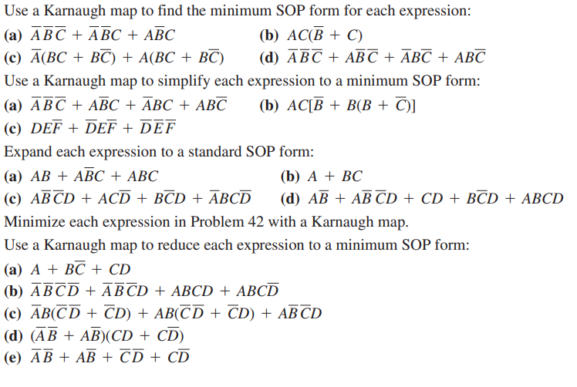
5.3. MINIMIZATION OF BOOLEAN FUNCTIONS.
5.3.3 K-map method:
37

Slide 38
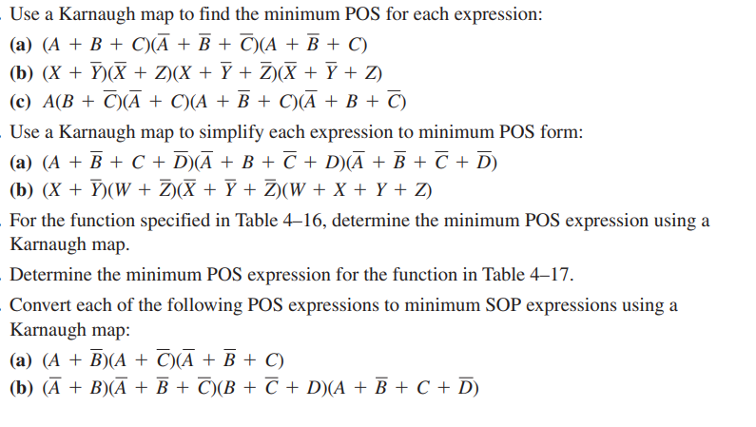
5.3. MINIMIZATION OF BOOLEAN FUNCTIONS.
5.3.3 K-map method:
38

Slide 39
THANK YOU!

